Slide 1
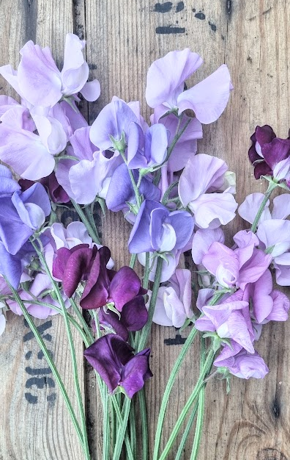
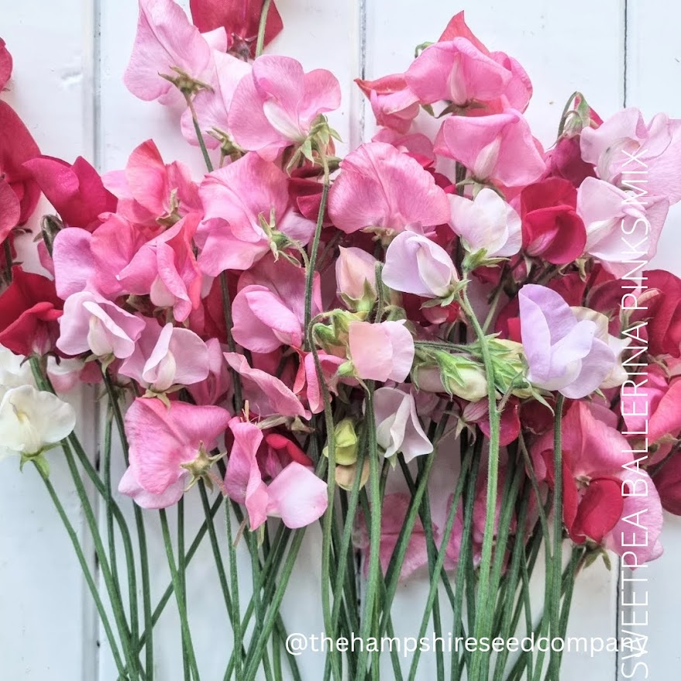
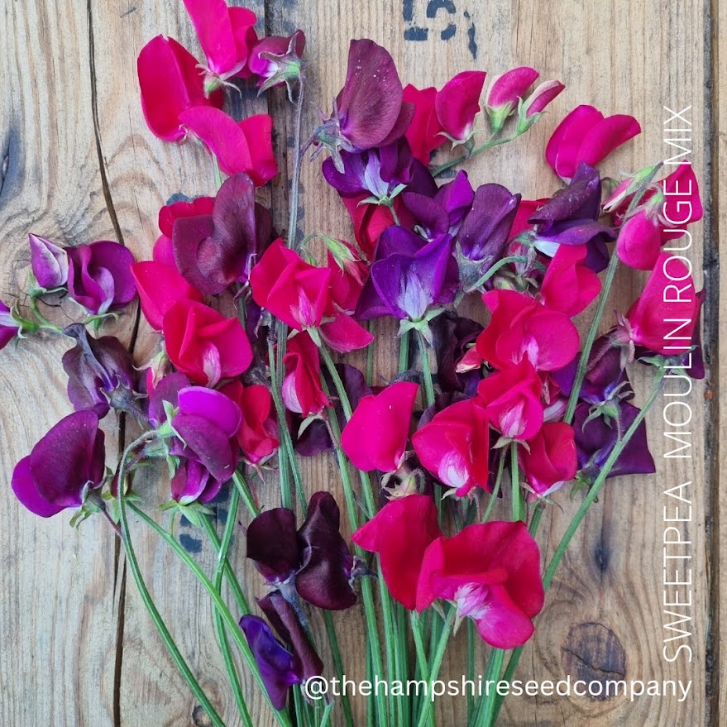
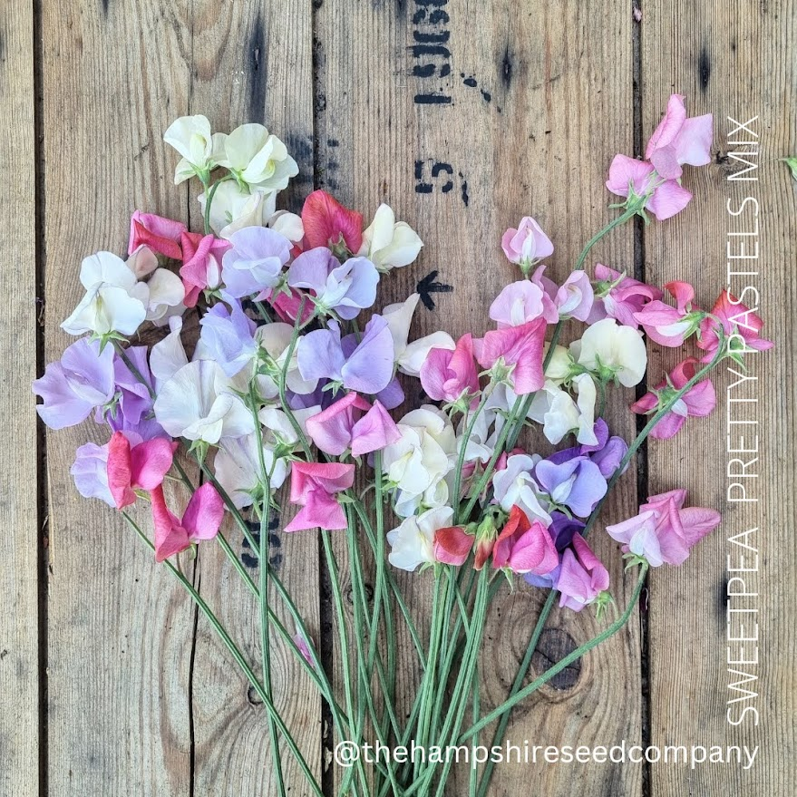
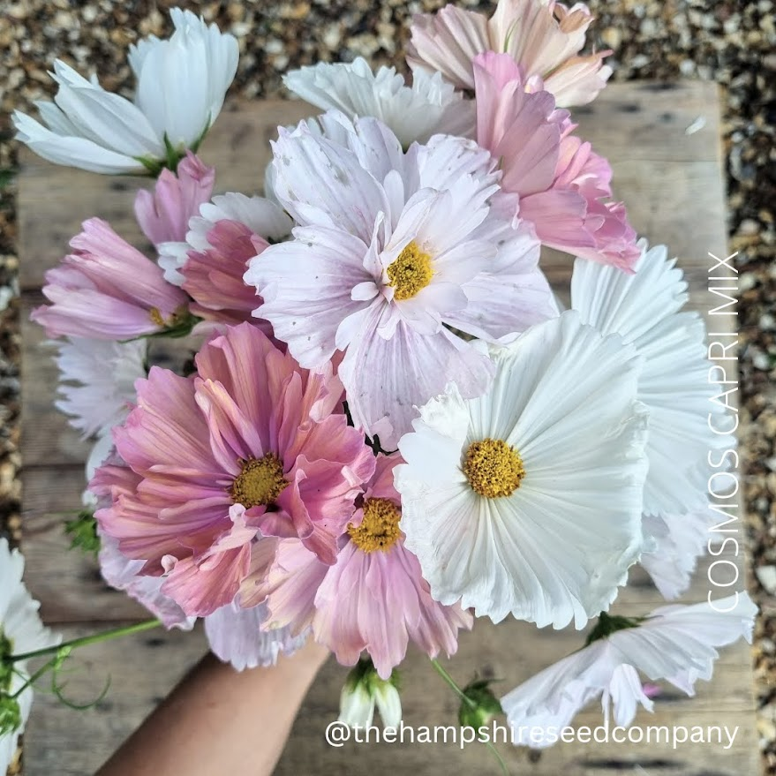
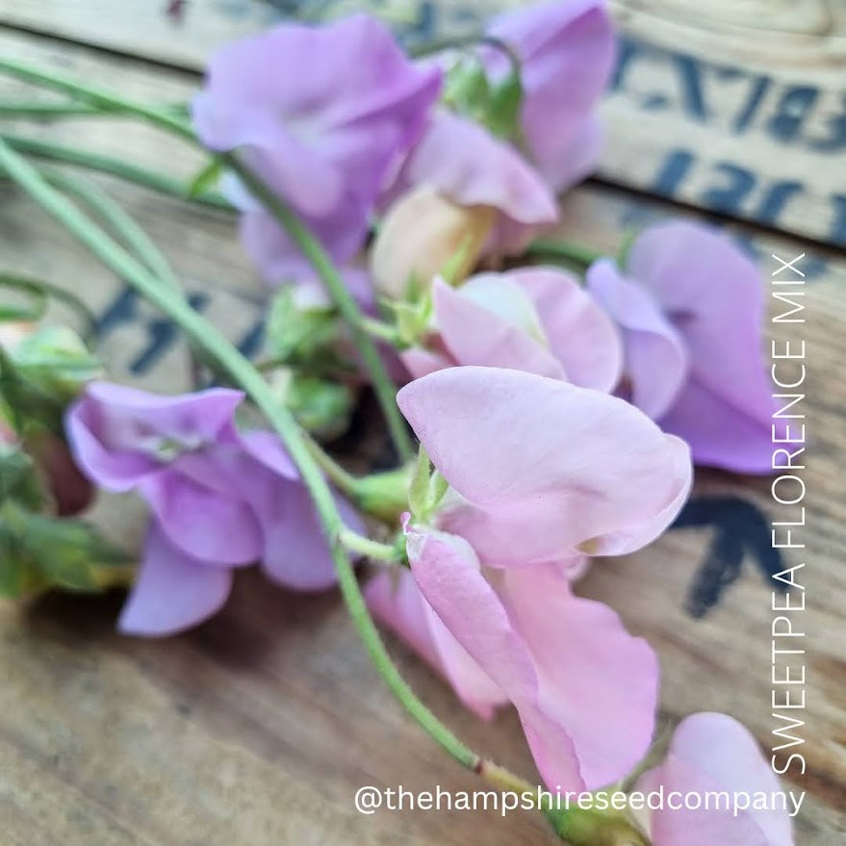
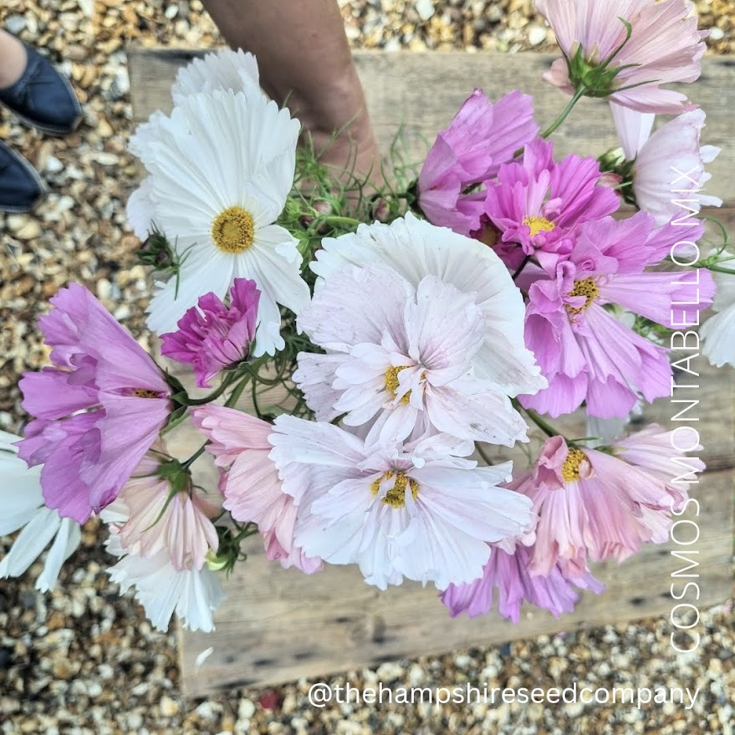
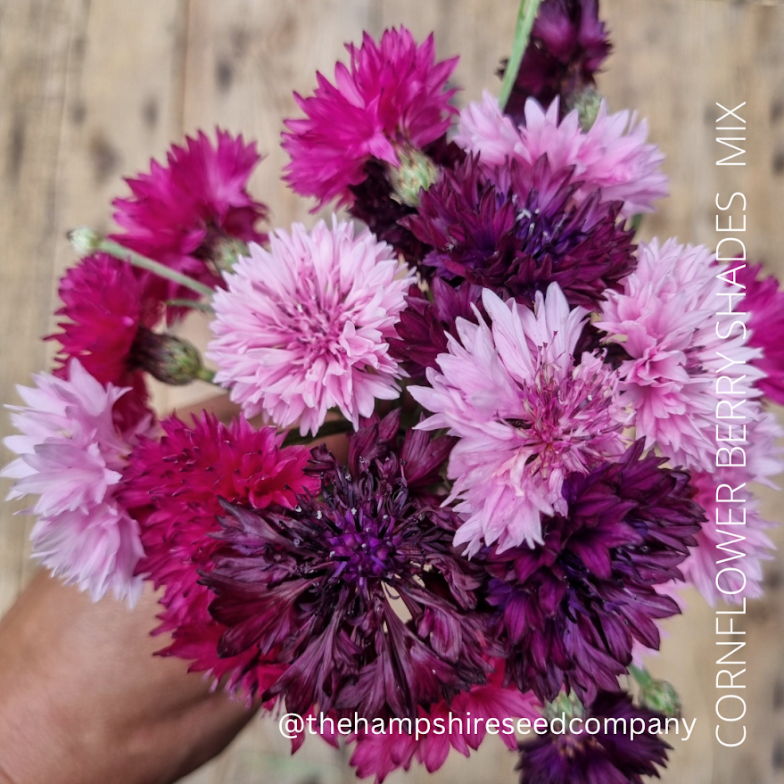
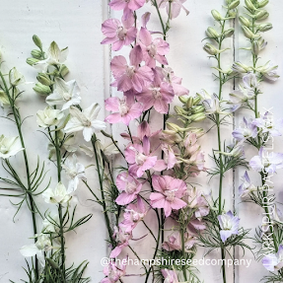
Leaning into 2025 with our Exclusive Seed Mixes
Let me introduce you to……
The first 6 months of business has been a marathon of picking, packing and taking photos of all the collections – In addition to all of the sowing and growing we do.
Our first exclusive collections have been born and launched early to gauge customer reactions and honestly we are blown away with the response.
For A/W 2024/25 we have launched with Sweet Peas, Larkspur, Cosmos and Cornflowers. With years of developing floral looks for clients weddings and events it was great to finally be able to offer flower farmers and gardeners some tailor made solutions in beautiful colour combinations.
Cosmos Favelloni
Cosmos Montabello
Cosmos Capri
Sweet Pea Madonna Mix
Sweet Pea Madonna Mix
Sweet Pea Ballerina Pink Mix
Sweet Pea Moulin Rouge
Sweet Pea Love Hearts Mix
Coming this Autumn
Cornflower Berry Shades Mix
Larkspur Pastels Mix
Release - September 2024
Website: www.thehampshireseedco.com
Contact: Jane Westoby - Founder & Creative Director
hello@thehampshireseedco.com | 07740457730

