Slide 1
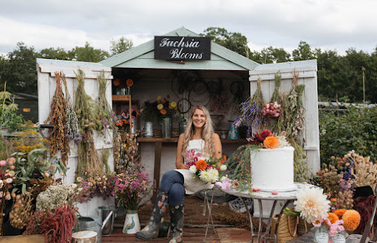
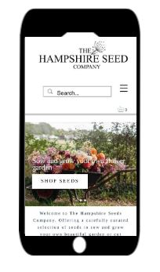
Florist & Flower Farmer Unveils Exciting New Online Seed Shop!
Release - August 2024
The Hampshire Seed Company launched in February 2024 to share beautiful seed varieties with farmer florists and gardeners.
“With 30 years of experience growing flowers for the garden, and speciality cut flowers for weddings and events for 6 years, the time was right to branch out. People see all the beautiful flowers on Instagram but don't know where to start, so we offer lots of beginners growing guides through to expert tips for growing the trickiest of seeds”.
There is also so much choice out there but much of it is aimed at general gardening rather than specifically growing for cut flowers, and it’s not always clear what will make a good cut flower. We include so much information on our packs and website so that growers know, not just how to sow the seeds and any special tips and tricks, but also when to harvest the blooms for best vase life and how long they will last.
Our range is heavily curated to offer specific colour palettes, textures & forms which today’s florists and flower farmers are looking for. Showcasing unusual grasses and seed pods, and our very own exclusive seed mixes.
I hope that with a florists eye and a degree in design that I can bring a different perspective to the world of cut flower seeds.
The site was soft launched back in February which really was very late in the season as far as the growing calendar goes, but the past six months have enabled us to get to know our customers, what they want from us and what they like to sow, grow and read about. It’s also allowed us to build our supply base and give growers the chance to grow especially for us.
Website: www.thehampshireseedco.com
Contact:
Jane Westoby - Founder & Creative Director
hello@thehampshireseedco.com
07740457730

